Slide 1
Transformation Matrices

Slide 2
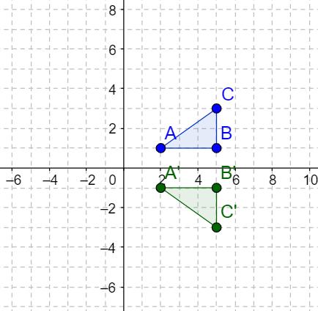
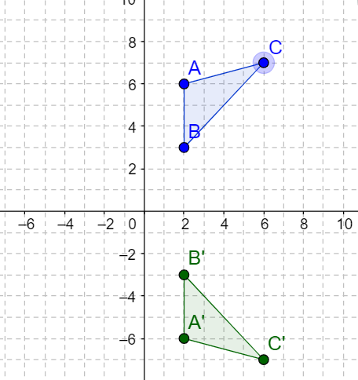
Transformations in the plane
How do we use Matrices to perform geometric transformations?

Slide 3
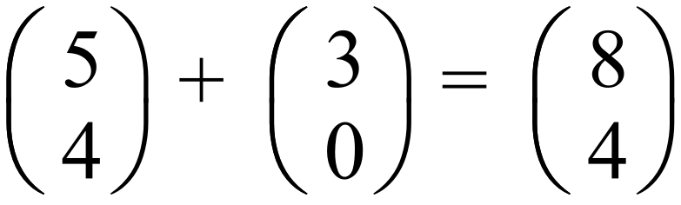
Matrices for Translations
Object point
Translation vector
Image point
Translation matrices are always given as column vectors.

Slide 4
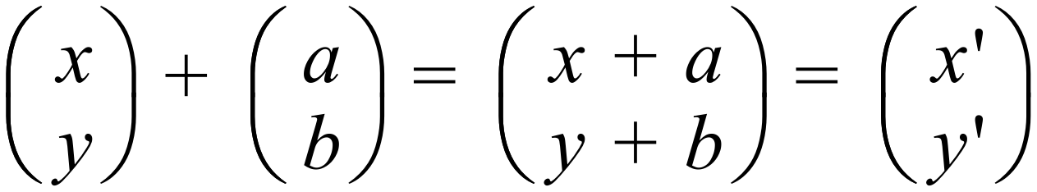
In general:
In a translation, distances and areas are preserved.
Notes:
Invariant points – a point which is mapped onto itself. It is its own image.

Slide 5
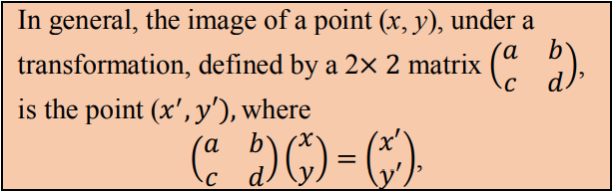
Deriving matrices for transformations
Notes:
The transformation matrix can be likened to a “function” that maps an object onto it’s image.
The transformation matrix is a PREMULTIPLIER.

Slide 6
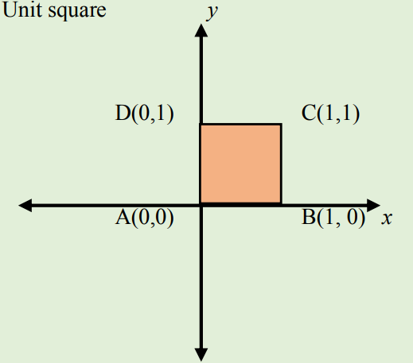
Consider a unit square
Notes:
Consider a unit square, drawn in the first quadrant whose coordinates are (0, 0), (1, 0), (1, 1) and (0, 1). Under a given transformation each point (x, y) will move to (𝑥’, 𝑦′)

Slide 7
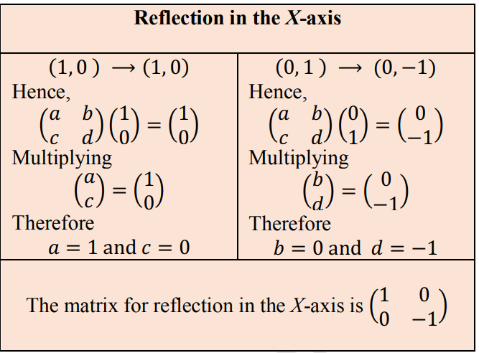
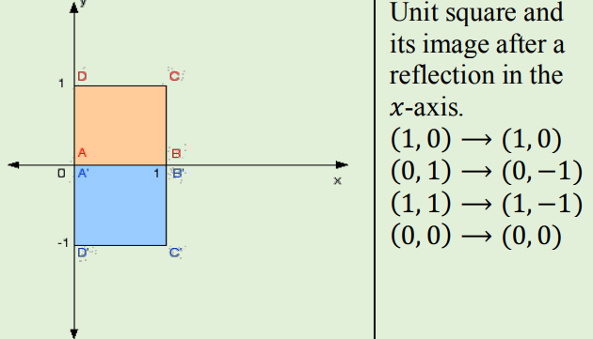
Matrices for reflection in the x axis
Notes:
Note that (1,0) and (0,0) are invariant points. They map onto themselves.

Slide 8
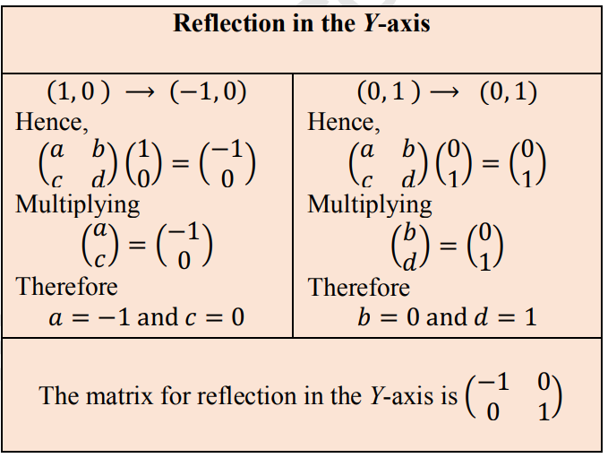
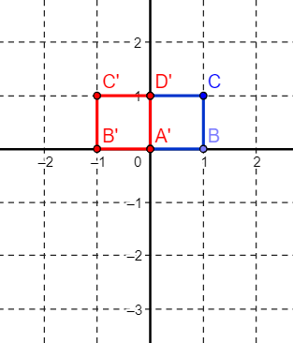
Matrices for reflection in the y axis
Notes:
Note that (1,0) and (0,0) are invariant points. They map onto themselves.

Slide 9
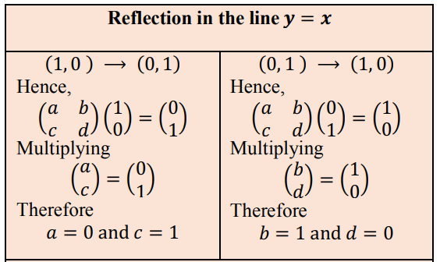
Matrices for reflection in line y=x
Notes:
Note that (1,0) and (0,0) are invariant points. They map onto themselves.

Slide 10
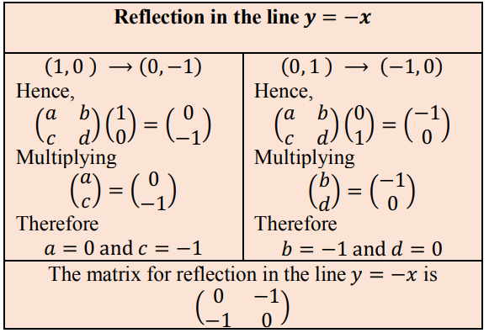
Matrices for reflection in line y=-x
Notes:
Note that (1,0) and (0,0) are invariant points. They map onto themselves.

Slide 11

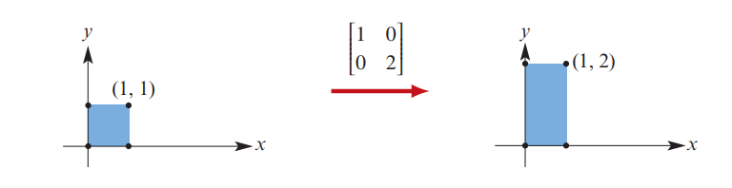

DILATIONS FROM THE X AXIS

Slide 12

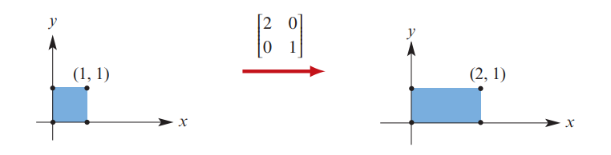

DILATIONS FROM THE Y AXIS

Slide 13
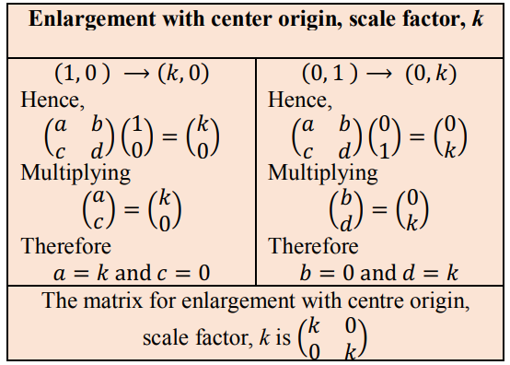
DILATIONS FROM THE X AND Y AXES

Slide 14
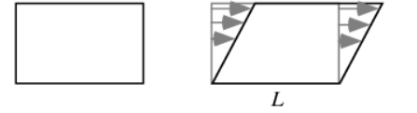
SHEARS
Notes:
A transformation in which all points along a given line L remain fixed while other points are shifted parallel to L by a distance proportional to their perpendicular distance from L . Shearing a plane figure does not change its area. The shear can also be generalized to three dimensions, in which planes are translated instead of lines.

Slide 15
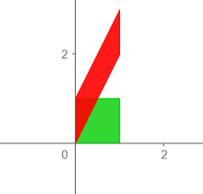
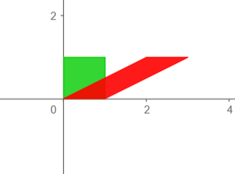
SHEARS
Notes:
A transformation in which all points along a given line L remain fixed while other points are shifted parallel to L by a distance proportional to their perpendicular distance from L . Shearing a plane figure does not change its area. The shear can also be generalized to three dimensions, in which planes are translated instead of lines.

Slide 16


SHEARS
Notes:
A transformation in which all points along a given line L remain fixed while other points are shifted parallel to L by a distance proportional to their perpendicular distance from L . Shearing a plane figure does not change its area. The shear can also be generalized to three dimensions, in which planes are translated instead of lines.

Slide 17
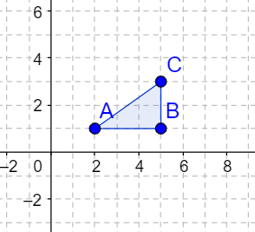
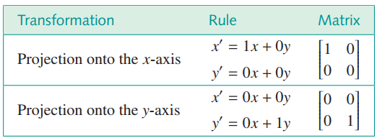
Projections
Notes:
A transformation in which all points along a given line L remain fixed while other points are shifted parallel to L by a distance proportional to their perpendicular distance from L . Shearing a plane figure does not change its area. The shear can also be generalized to three dimensions, in which planes are translated instead of lines.

Slide 18

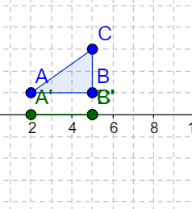
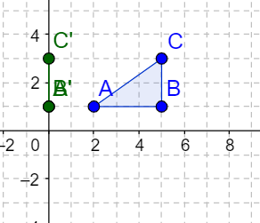
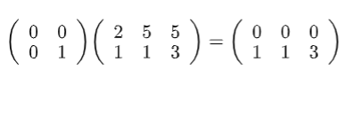
Projections
Notes:
A transformation in which all points along a given line L remain fixed while other points are shifted parallel to L by a distance proportional to their perpendicular distance from L . Shearing a plane figure does not change its area. The shear can also be generalized to three dimensions, in which planes are translated instead of lines.

Slide 19
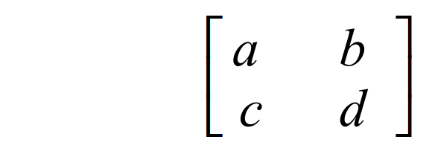
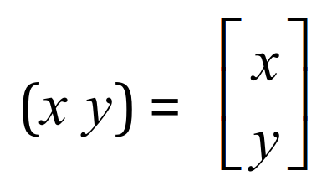









Linear transformations

Slide 20
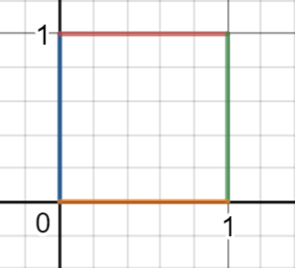
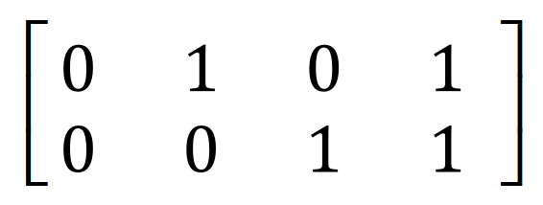

Slide 21
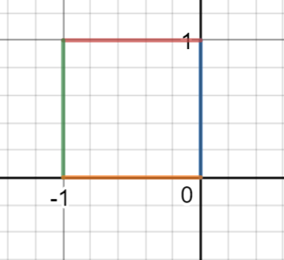
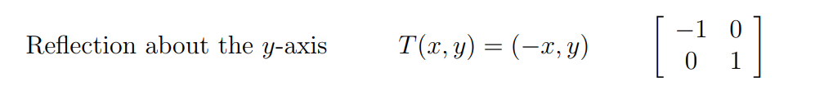
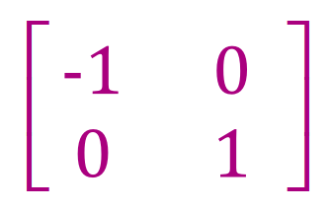



Slide 22










Slide 23
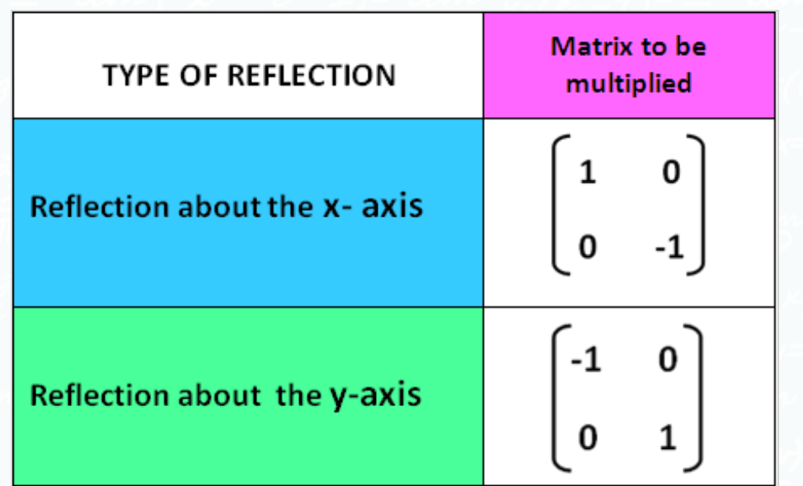
Transformation Matrices

Slide 24
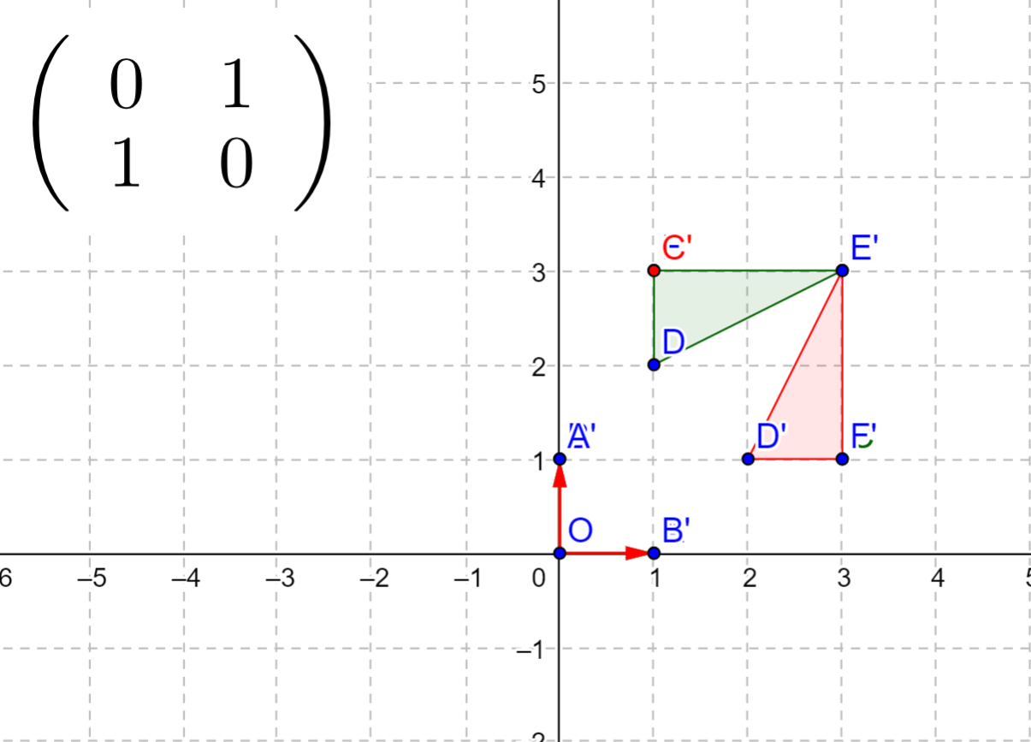
Notes:
Reflection through the line y=x.

Slide 25
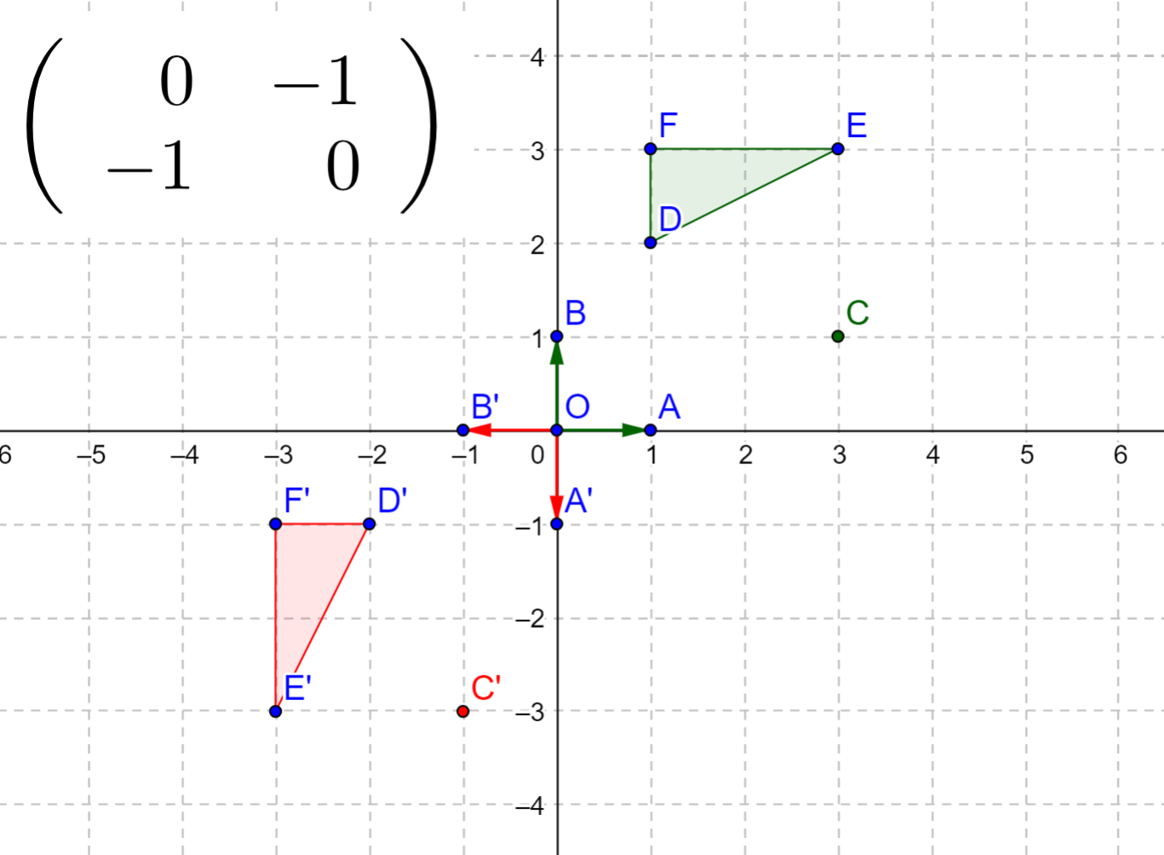
Notes:
Reflection through the line y=-x.

Slide 26
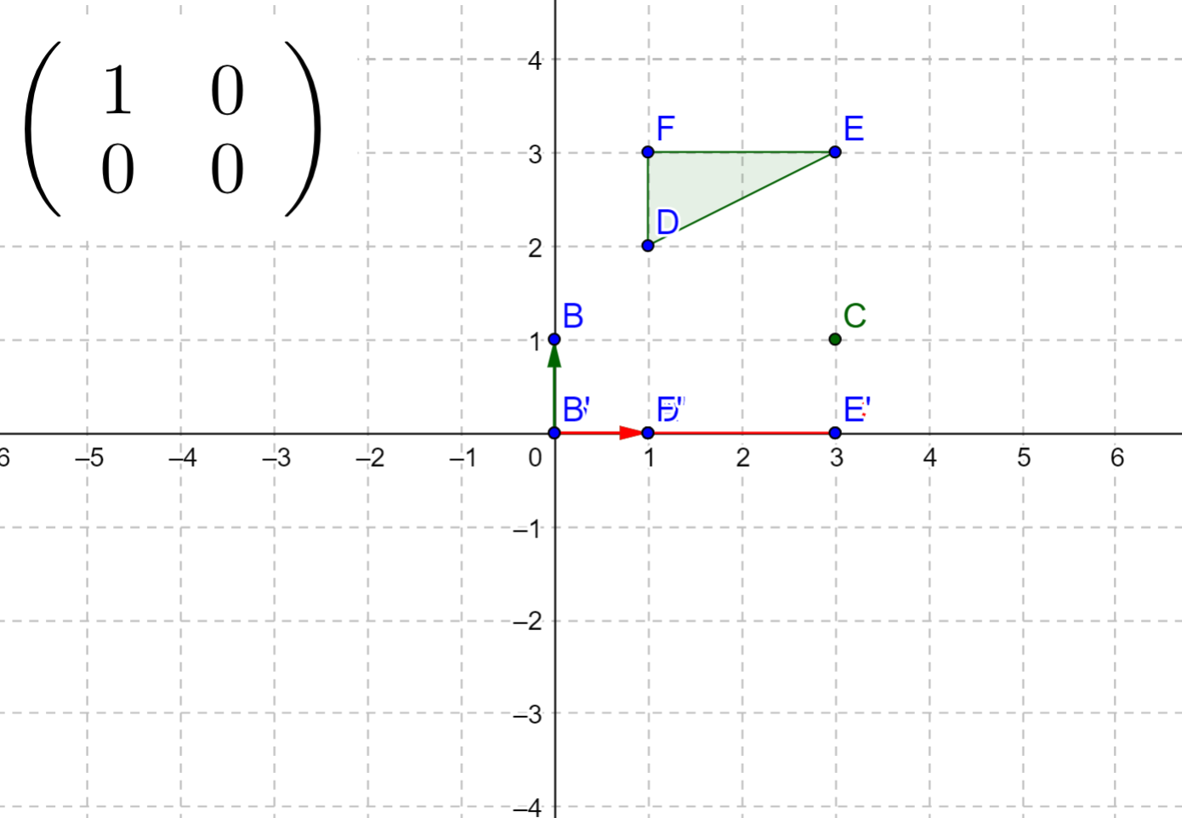
PROJECTION ONTO THE
X AXIS

Slide 27
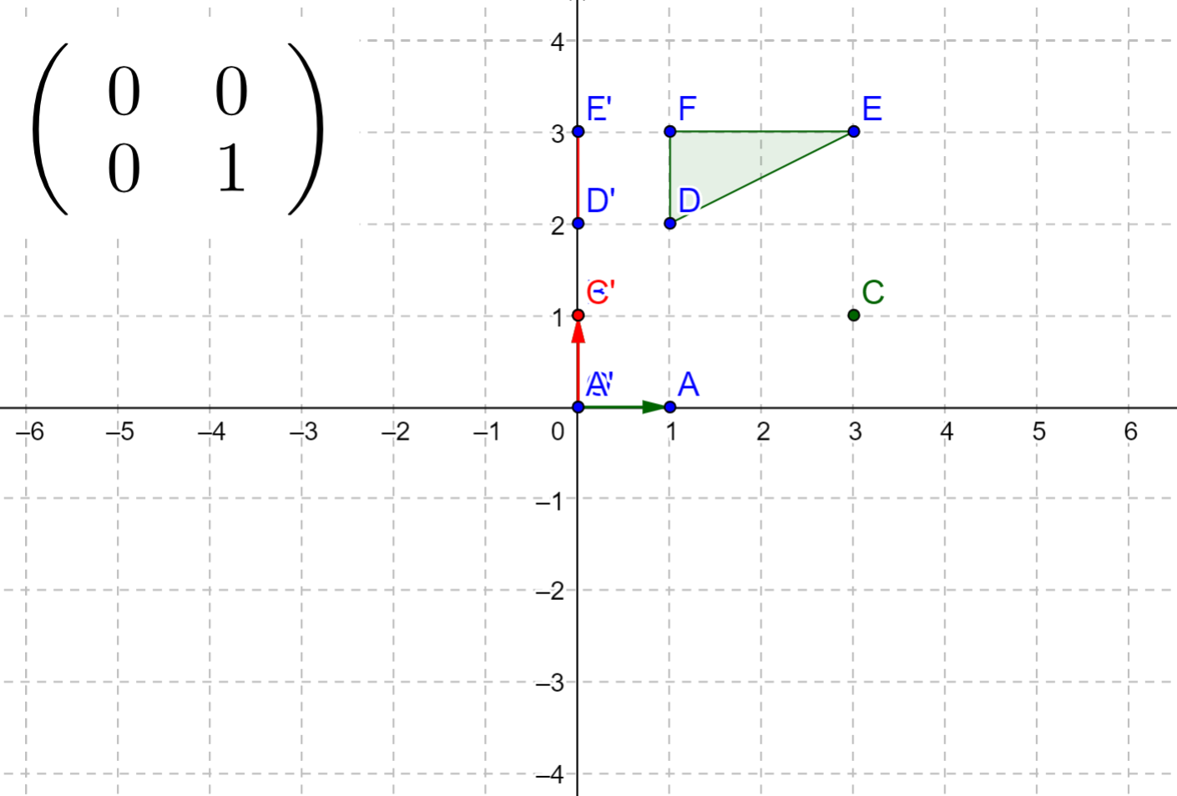
PROJECTION ONTO THE
Y AXIS

Slide 28
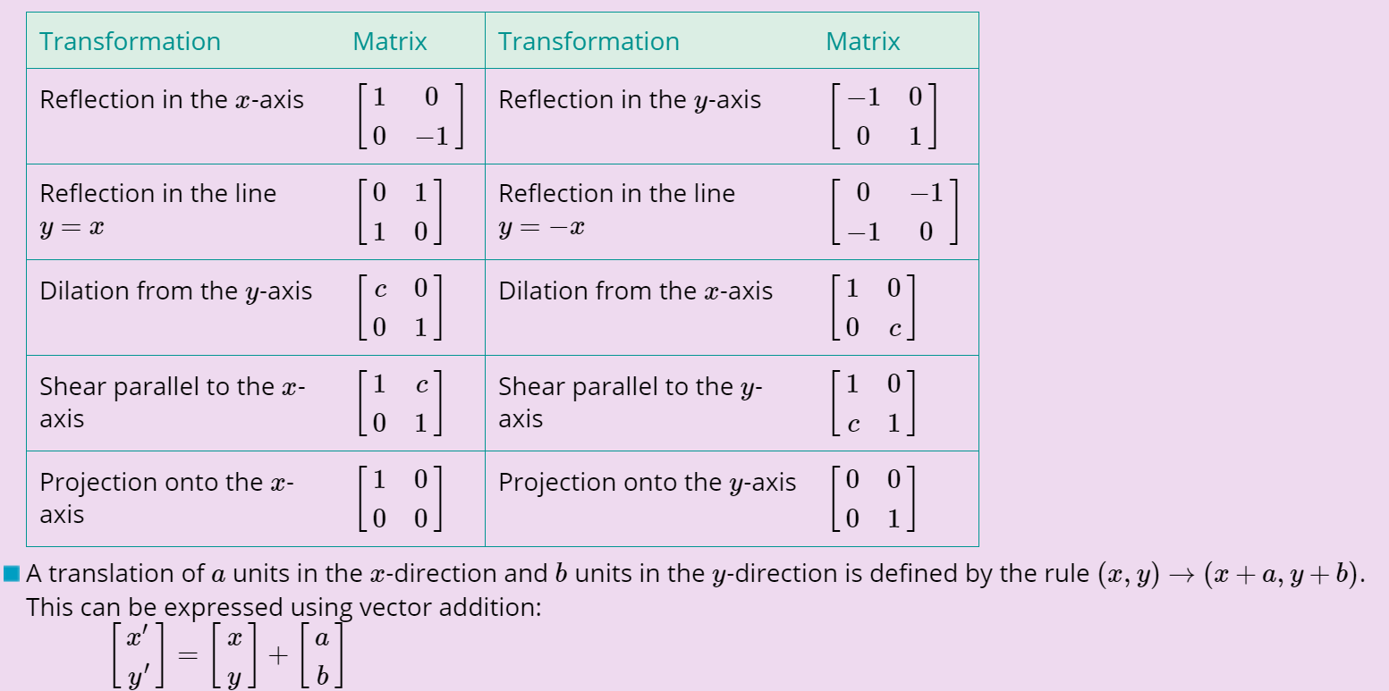

Slide 29
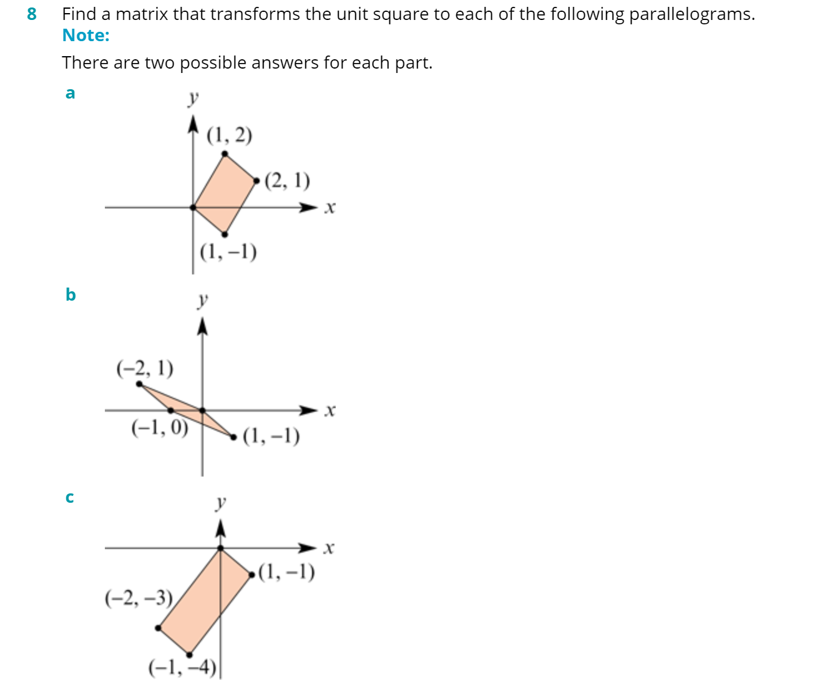






Slide 30








Slide 31

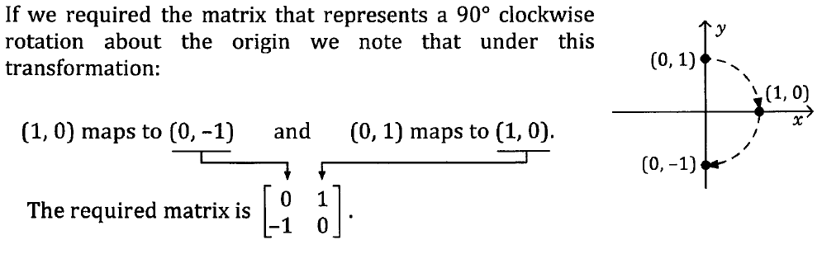

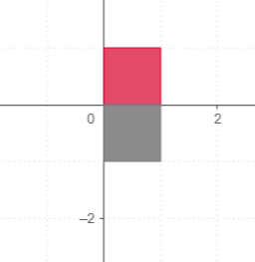
Rotations

Slide 32
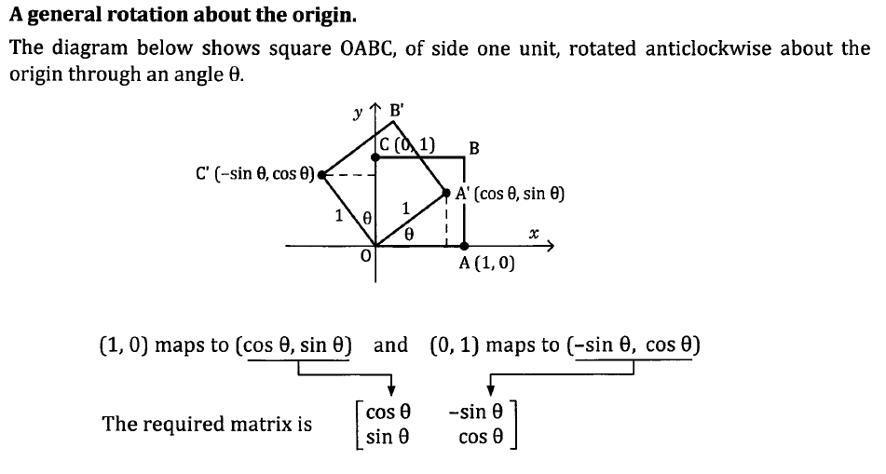
General Rotations about the origin

Slide 33
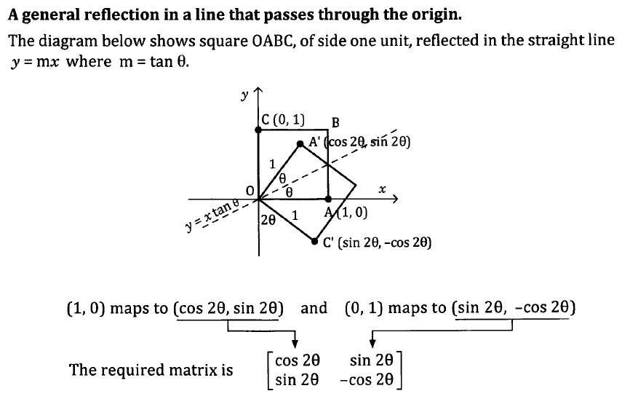
General reflection in a line passing through the origin

Slide 34
General reflection in a line passing through the origin

Slide 35
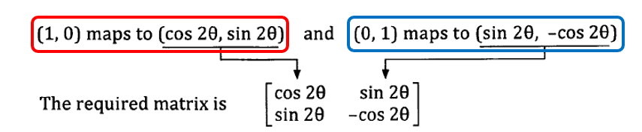
General reflection in a line passing through the origin

Slide 36
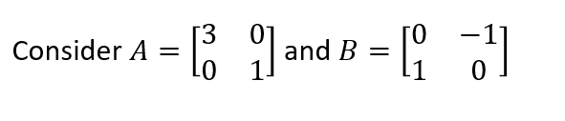
Composition of transformations

Slide 37
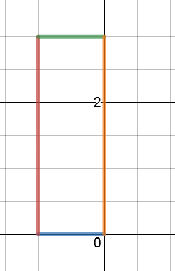
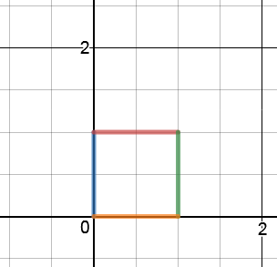
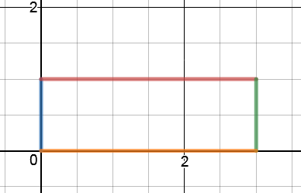
Composition of transformations
Notes:
How is the transformation obtained?

Slide 38
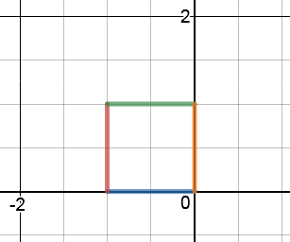
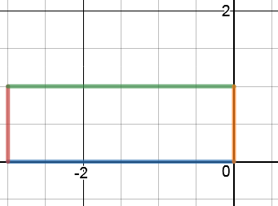
Composition of transformations
Notes:
How is the transformation obtained?

Slide 39
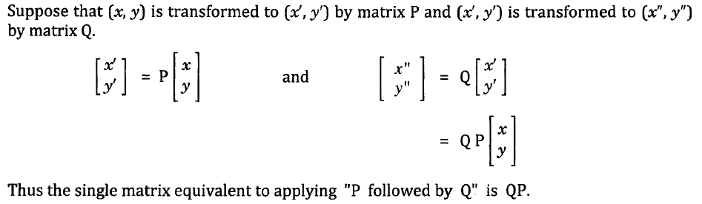
Composition of transformations
Notes:
How is the transformation obtained?

Slide 40
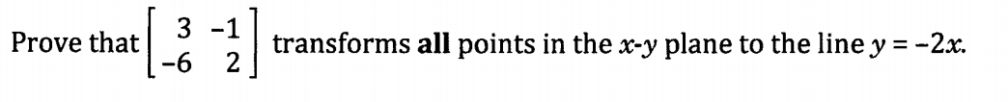

Slide 41


Slide 43


Slide 44





Inverse of transformation Matrices

Slide 45


Slide 46







Slide 47





